Slide 1
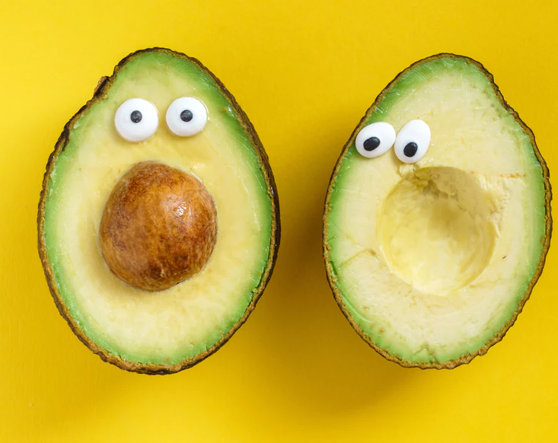
The avocado issue
JEFF, SULAV, JERRY & JUAN
MARKETING ANALYTICS
SYRACUSE UNIVERSITY- THE WHITMAN SCHOOL

Slide 2
- overview of the avocado market - Researching the different habits of avocado buyers - UNDERSTANDING SALES TRENDS - segmenting customers into clustered groups - RECOMMENDING FUTURE DIRECTION

Slide 3
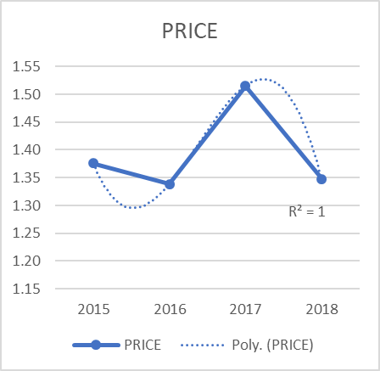
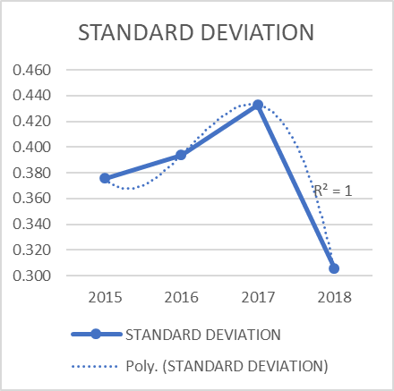
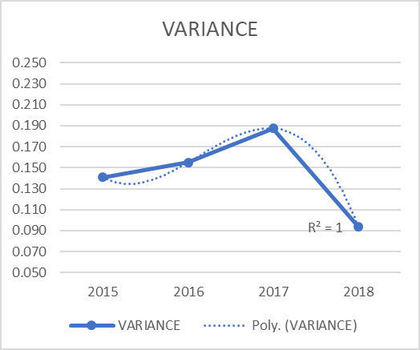
-2107 SAW THE HighEST AVERAGE PRICE FOR THE FRUIT 0.12 CENTS ABOVE THE MEAN (1.52, 2017; 1.4, MEAN) -HIGHEST VOLUME IN Q1 2018 FOLLOWED BY Q2 2016 -LOWEST VOLUME Q4 2015 -LOWEST PRICE Q1,Q2 2016 -APPEARS THAT A SHORTAGE IN Q4 2015, WAS FOLLOWED BY SIX MONTHS OF FLOODING IN Q1, Q2 2016
The avocado Market
Row Labels | PRICE | S_DEV | VARIANCE | SDEV/P | VARIANCE2
2015 | 1.38 | 0.376 | 0.141 | 0.2730426 | 0.10255337
2016 | 1.34 | 0.394 | 0.155 | 0.29411052 | 0.11579366
2017 | 1.52 | 0.433 | 0.187 | 0.28572224 | 0.12369077
2018 | 1.35 | 0.306 | 0.094 | 0.22697643 | 0.0694225

Slide 4
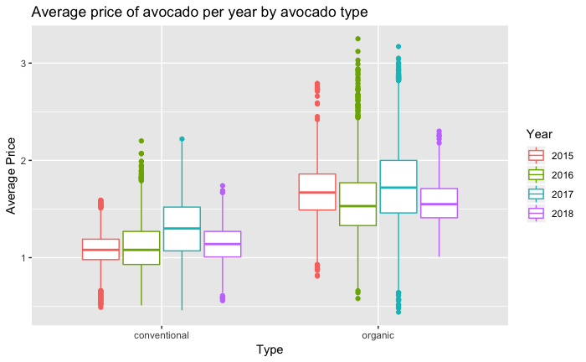
-LARGEST PRICE VARIATION 2017, FOLLOWED BY 2016. -LOWEST VARIATION 2018. -LACK OF PRICE VARIATION IN 2018 LIKELY CAUSED BY MISSING Q2-Q4 -MOST VARIATION IN PRICE 2017; BUT MOST VARIATION AS A PROPORTION OF PRICE 2016 -LARGEST GAP BETWEEN HIGHEST AND LOWEST PRICE 2017 -LARGEST PRICE SWING 2017, MOST PRICE CHANGES 2017, PRICES CHANGES AS A PROPORTION OF PRICE 2016
There appear to be seasonal trends in avocado pricing. In the summer and fall, avocado prices for both conventional and organic avocados tend to be highest.
Avocado prices appear to be gradually increasing over time. Looking at the maximum average price of an avocado in each year shows this trend most clearly. For example, consider the red points for the conventional avocados. The highest average price was a little over $1.00 in 2015, about $1.40 in 2016, and slightly over $1.60 in 2017.

Slide 5
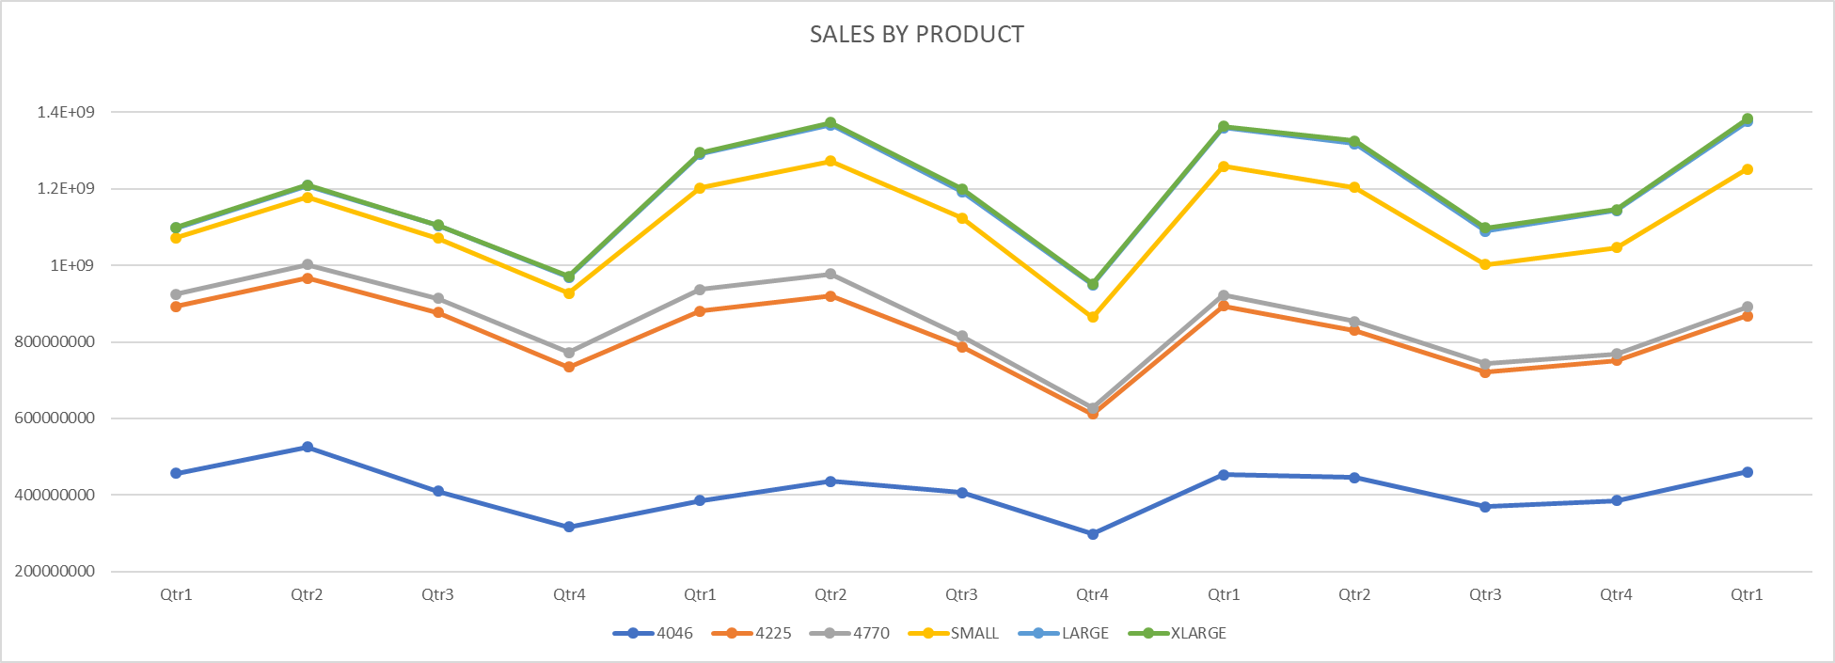
Sales by SIZE
4046 | 4225 | 4770 | SMALL | LARGE | XLARGE
1709449981 | 1761054036 | 142772394.6 | 634682705 | 132066400 | 5443128.28
456697236.2 | 436495632.4 | 31835174.69 | 146661517 | 26865247.2 | 751071.27
525695407.4 | 441320026.1 | 34647321.13 | 176616993 | 30595505 | 879931.24
410238593.4 | 466226320.6 | 37679052.41 | 156968887 | 32581252.5 | 1471398.56
316818744.4 | 417012057 | 38610846.32 | 154435309 | 42024395.7 | 2340727.21
1525122892 | 1672728288 | 159879845 | 1106494240 | 336626342 | 20038284.8
385031010.9 | 495167655.2 | 57210827.05 | 264917370 | 89209040.1 | 3728072.24
436086395.7 | 483782323.5 | 58172982.04 | 294949707 | 94085782.4 | 6314245.81
405802465.5 | 380966706.6 | 28142016.94 | 308925959 | 68881699.4 | 7656739.22
298203020.2 | 312811602.8 | 16354018.98 | 237701203 | 84449820.2 | 2339227.57
1652038132 | 1544734720 | 91217507.78 | 1222952525 | 399339040 | 23997172.3
452339071.2 | 441831340 | 28524805.37 | 336174415 | 100530601 | 4303382.65
445262206.4 | 384531194.5 | 23919667.08 | 349493676 | 114852803 | 7896174.51
368954129.5 | 352175021.9 | 21378661.99 | 259465074 | 87548550.4 | 8479693.81
385482724.5 | 366197163.2 | 17394373.34 | 277819360 | 96407085.4 | 3317921.37
460499734.1 | 407758674.3 | 22932594.79 | 360741368 | 123583988 | 7210591.87
460499734.1 | 407758674.3 | 22932594.79 | 360741368 | 123583988 | 7210591.87
-SMALL AND LARGE HASS SEEM TO DOMINATE THE AVOCADO MARKET
-X-LARGE (6 COUNT) BAGS SEEM TO BE THE MOST UNPOPULAR CHOICE
-SALES TEND TO BE HEALTHIER IN QUARTER 1 AND TWO ; MOST POPULAR IN Q2
-Q3 AND Q4 MOST UNPOPULAR, WITH Q4 SALES WORST IN MOST CASES.
-VOLUME SALES SEEM TO BE MOVING IN CONJUNCTION WITH ONE ANOTHER.

Slide 6
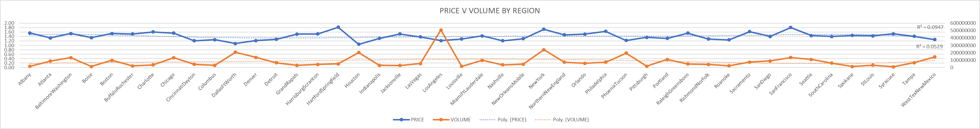
regional sales
-PRICE VARIES MOST OFTEN IN PHEONIX/TUCSON, WEST TEXAS, PORTLAND, BOISE, SPOKANE
-PRICE VARIES LEAST PITTSBURGH, SYRACUSE, ALBANY, BUFFALO/ROCHESTER, ALBANY, PHILADELPHIA
-PHOENIX (SD0.548, SDP0.448) AND PITTSBURGH (SD0.175, SDP0 .129) VARY SIGNIFICANTLY FROM THE REST OF THE AREAS.
-SAN FRANCISCO HAS LARGE DEVIATION, BUT AVERAGE SDP, THUS SAN FRANCISCO'S DEVIATION IS CAUSE MORE SO BY EXTREME PRICES THAN BY SIMPLE VARIATION.
--THIS MEANS THAT SF DEVIATION APPEARS TO BE HIGHER BUT IT ONLY APPEARS SO BECAUSE ITS PRICES ARE MORE EXTREME THAN OTHER REGIONS.
-PITTSBURG HAS LEAST VARIANCE, WHICH MEANS THAT THE PRICE REARLEY VARIES IN THAT REGION.

Slide 7
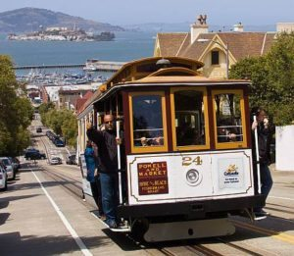
-SAN FRANCISCO HAS THE HIGHEST VARIATION; THE PRICE VARIES MORE OFTEN THAN ANYWHERE ELSE. -SAN FRANCISCO HAS THE LARGEST STANDARD DEVIATION FOLLOWED BY PHOENIX/TUCSON. PRICE DIFFER FROM THE AVERAGE AT A GREATER MAGNITUDE. -VARIATION AS A PROPORTION OF PRICE IS A TRUE MEASURE OF VARIANCE OF PRICE DISCOUNTING PRICE DIFFERENCES FROM REGION TO REGION. PHOENIX/TUCSION AND WEST TEXAS HAVE THE OVERALL HIGHEST VARIANCE. PRICES IN THESE AREAS FOR AVOCADOS ARE ERRATIC AND CAN VARY IMMESELY FROM HIGH TO LOW. -LEAST TRUE VARIANCE CAN BE FOUND IN PITTSBURGH AND SYRACUSE. PRICES FOR AVOCADOS IN THESE TWO REGIONS ARE STEADY.THIS IS FOLLOWED BY ALBANY, BUFFALO AND RICHMOND. -HOUSTON AND DALLAS ENJOY THE LOWEST AVERAGE PRICES FOLLOWED BY CINCINNATI, NASHVILLE DENVER AND PHOENIX/TUCSON. -HARTFORD AND SAN FRANCISCO HAVE THE HIGHEST PRICES, FOLLOWED BY NEW YORK. -LARGEST CONSUMPTION REGIONS INCLUDE: LOS ANGELES, NEW YORK, DALLAS, HOUSTON AND PHEONIX/TUCSON. SOME OF THIS MAY BE CAUSE BY POPULATION DIFFERENCES. LOS ANGELES IS BY FAR THE BIGGEST CONSUMER OF AVO'S BY REGION. -FEWEST CONSUMERS: SYRACUSE, BOISE, SPOKANE, ALBANY AND LOUISVILLE CONSUME THE LEAST AVOCADOS.

Slide 8
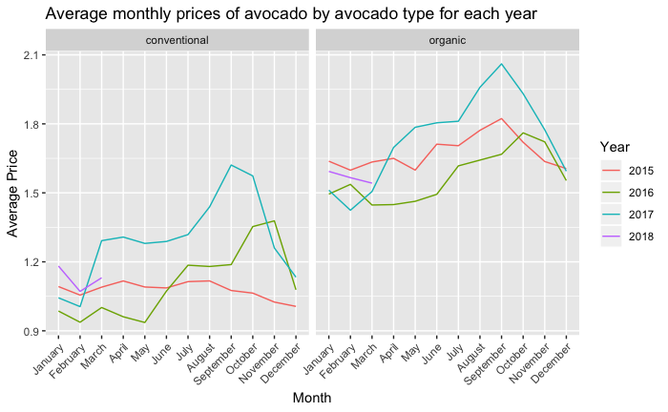
Organic vs non-organic
TOTAL VOLUME FOR BOTH ORGANIC AND NON-ORGANIC IS INCREASING DRASTICALLY
TOTAL VOLUME INCREASING PRICE STAYING STEADY. PRICE VARIATION SEMS TO BE INCREASING, THE PRICE VARIES MORE IN MAGNITUDE.
TOTAL VOLUME INCREASING PRICE IS LOWER THAN PRICE IN 2015; PRICE MAY BE DECREASING DUE TO INCREASED AVAILABILITY. 2015 CONSIDERED A NEW ITEM; 2018 NO LONGER CONSIDERED A NEW ITEM?

Slide 9
Understanding the customer
OF PRIMARY IMPORTANCE IS UNDERSTANDING OUR CUSTOMERS
WHO ARE THEY AND WHAT ARE THEY DOING?
WHAT ARE THEIR BUYING HABITS?
DOES LOCATION MATTER?

Slide 10
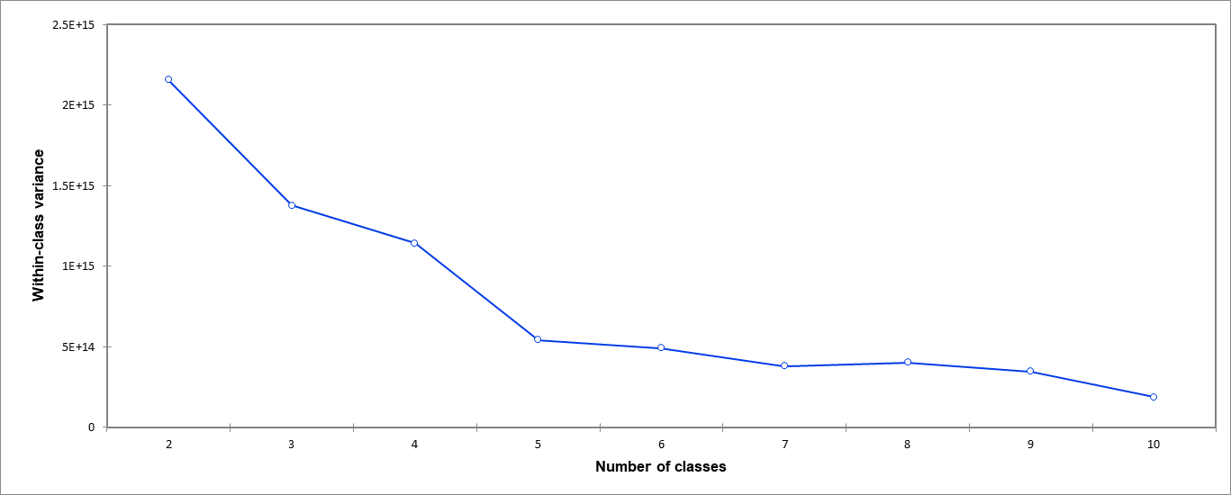
K-means
A K-MEANS CLUSTERING ALLOWS US TO DESCRIBE OUR CUSTOMERS CLEARER
K-MEANS REVEALED 5 SEGMENTS OF CUSTOMERS.

Slide 11
Group 3 Baltimore/Washington Boston Chicago New York Northern New England San Francisco
Group 1 Albany Boise Buffalo/Rochester Charlotte Cincinnati/Dayton Columbus Detroit Grand Rapids Harrisburg/ Scranton Hartford/-Springfield Indianapolis Jacksonville Las Vegas Louisville Nashville New Orleans/Mobile Philadelphia Pittsburgh Raleigh/Greensboro Richmond/Norfolk Roanoke Spokane St Louis Syracuse
Group 2 Atlanta Denver Miami/Ft Lauderdale Orlando Portland Sacramento
San Diego Seattle South Carolina Tampa
Group 5 los Angeles
Group 4 Dallas/Ft Worth
Houston
Phoenix Tucson
West Tex/New Mexico

Slide 12

Group 1
REGIONS
24
AVERAGE PRICE
$ 1.43
LARGE AVOCADOS
52%
SMALL AVOCADOS
37%
SMALL BAGS
77%
LARGE BAGS
21%

Slide 13

Group 2
REGIONS
10
AVERAGE PRICE
$ 1.41
LARGE AVOCADOS
40%
SMALL AVOCADOS
58%
SMALL BAGS
67%
LARGE BAGS
32%

Slide 14

Group 3
REGIONS
6
AVERAGE PRICE
$ 1.57
LARGE AVOCADOS
85%
SMALL BAGS
90%

Slide 15
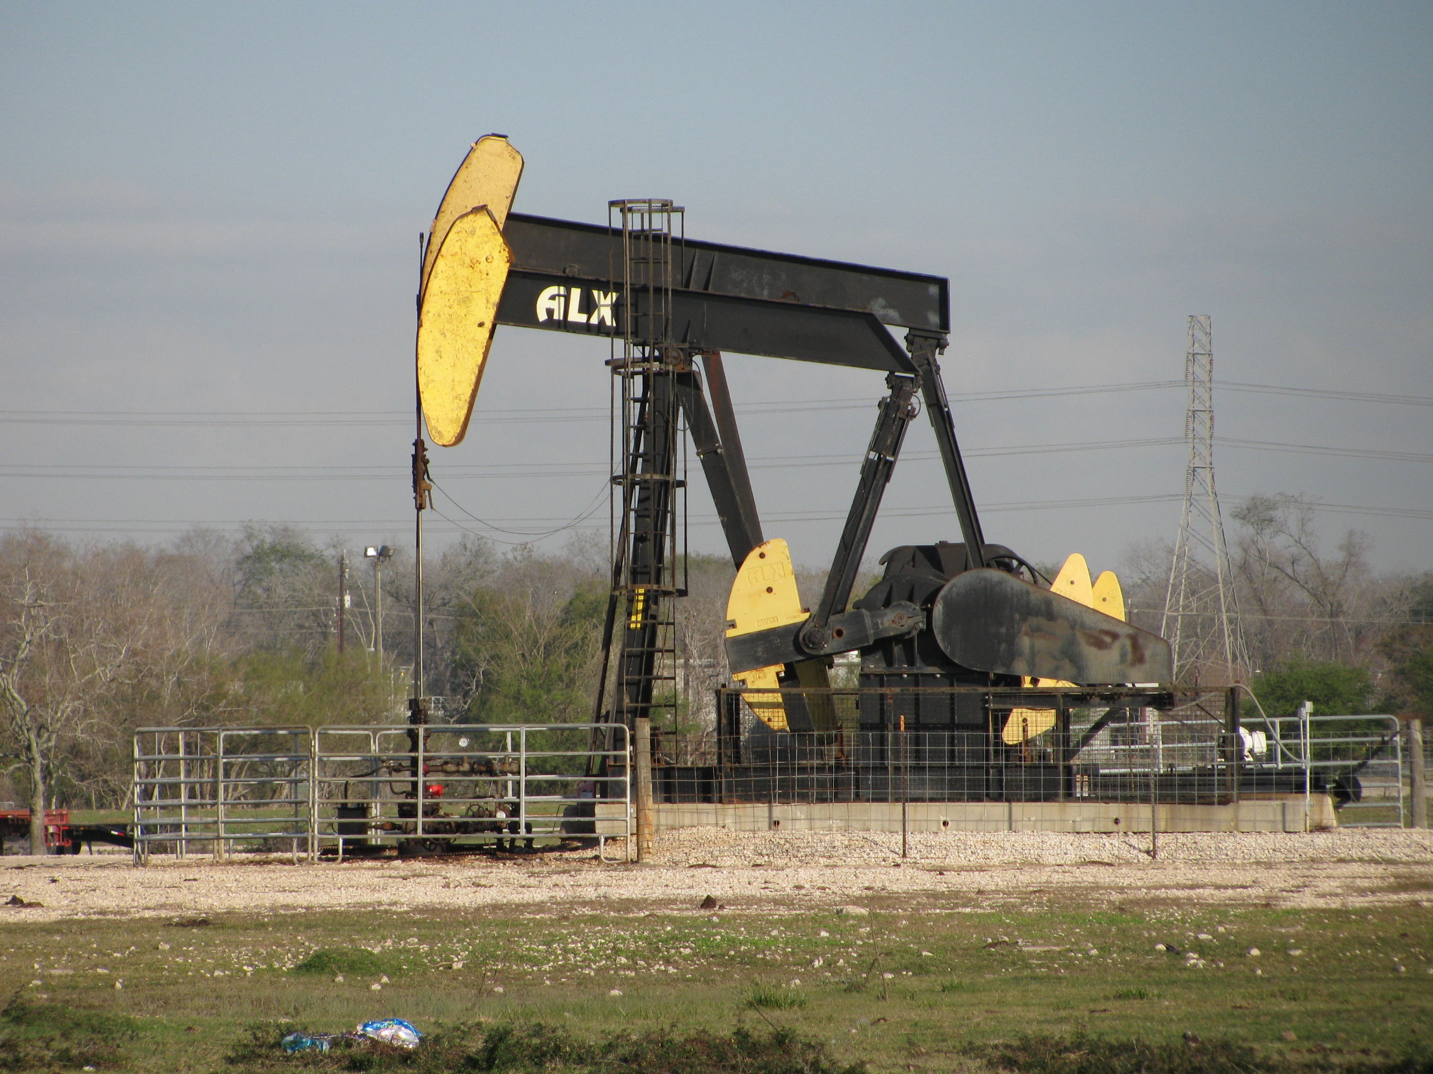
Group 4
REGIONS
4
AVERAGE PRICE
$ 1.15
LARGE AVOCADOS
26%
SMALL AVOCADOS
71%
SMALL BAGS
67%
LARGE BAGS
23%

Slide 16
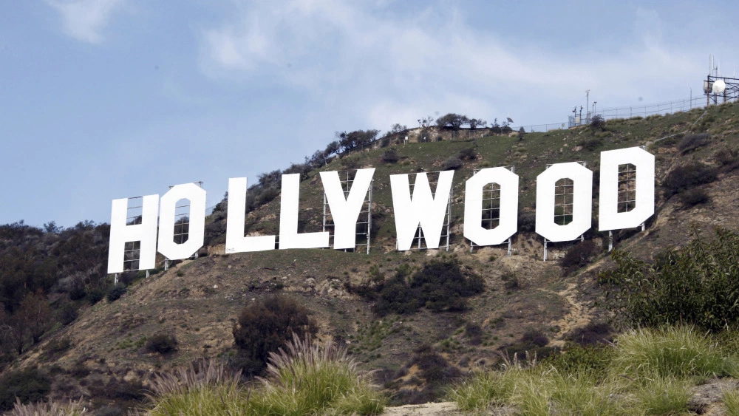
Group 5
REGIONS
1
AVERAGE PRICE
$ 1.15
LARGE AVOCADOS
30%
SMALL AVOCADOS
66%
SMALL BAGS
93%

Slide 17
KEY TAKEAWAYS
-the closer you are to THE LESS YOU PAY
-The furthest from Mexico THE MORE YOU PAY.
-THE WORDS “X-LARGE” ARE HATED AMONGST THE AVOCADO COMMUNITY.
-PRICES ARE THE STEADIEST IN AREAS WITH LOW DEMAND FOR AVOCADOS
-ORGANIC AVOCADOS HAVE A HIGH CORRELATION TO PRICE.

